Slide 1

Chapter 3 Selections

Slide 2
Motivations
If you assigned a negative value for radius in Listing 2.1, ComputeArea.java, the program would print an invalid result. If the radius is negative, you don't want the program to compute the area. How can you deal with this situation?

Slide 3
Objectives
To declare boolean type and write Boolean expressions using comparison operators (§3.2).
To program AdditionQuiz using Boolean expressions (§3.3).
To implement selection control using one-way if statements (§3.4)
To program the GuessBirthday game using one-way if statements (§3.5).
To implement selection control using two-way if statements (§3.6).
To implement selection control using nested if statements (§3.7).
To avoid common errors in if statements (§3.8).
To program using selection statements for a variety of examples (BMI, ComputeTax, SubtractionQuiz) (§3.9-3.11).
To generate random numbers using the Math.random() method (§3.9).
To combine conditions using logical operators (&&, ||, and !) (§3.12).
To program using selection statements with combined conditions (LeapYear, Lottery) (§§3.13-3.14).
To implement selection control using switch statements (§3.15).
To write expressions using the conditional operator (§3.16).
To format output using the System.out.printf method and to format strings using the String.format method (§3.17).
To examine the rules governing operator precedence and associativity (§3.18).
(GUI) To get user confirmation using confirmation dialogs (§3.19).

Slide 4
The boolean Type and Operators
Often in a program you need to compare two values, such as whether i is greater than j. Java provides six comparison operators (also known as relational operators) that can be used to compare two values. The result of the comparison is a Boolean value: true or false.
boolean b = (1 > 2);

Slide 5
Comparison Operators
Operator Name
< less than
<= less than or equal to
> greater than
>= greater than or equal to
== equal to
!= not equal to

Slide 6
Problem: A Simple Math Learning Tool
This example creates a program to let a first grader practice additions. The program randomly generates two single-digit integers number1 and number2 and displays a question such as “What is 7 + 9?” to the student. After the student types the answer, the program displays a message to indicate whether the answer is true or false.
AdditionQuiz
Run

Slide 7
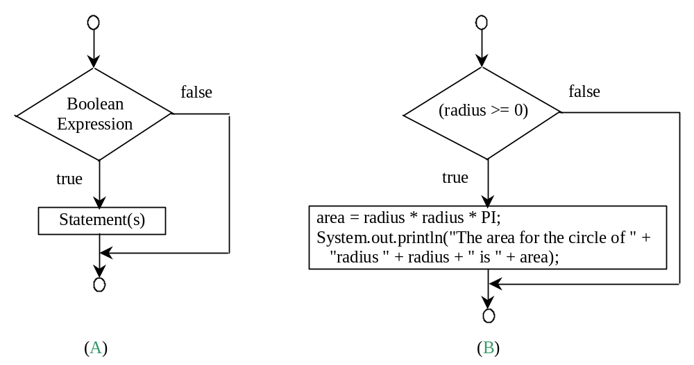
One-way if Statements
if (radius >= 0) {
area = radius * radius * PI;
System.out.println("The area"
+ " for the circle of radius "
+ radius + " is " + area);
}
if (boolean-expression) {
statement(s);
}

Slide 8


Note

Slide 9
Simple if Demo
Write a program that prompts the user to enter an integer. If the number is a multiple of 5, print HiFive. If the number is divisible by 2, print HiEven.
SimpleIfDemo
Run

Slide 10
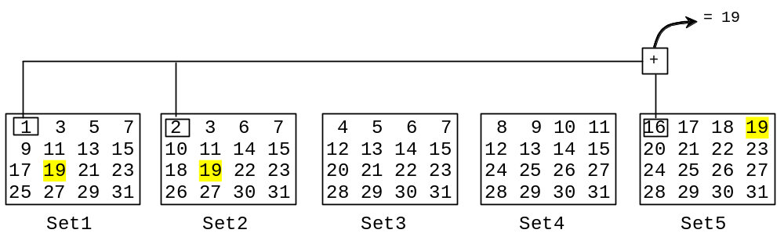

Problem: Guessing Birthday
The program can guess your birth date. Run to see how it works.
GuessBirthday

Slide 11
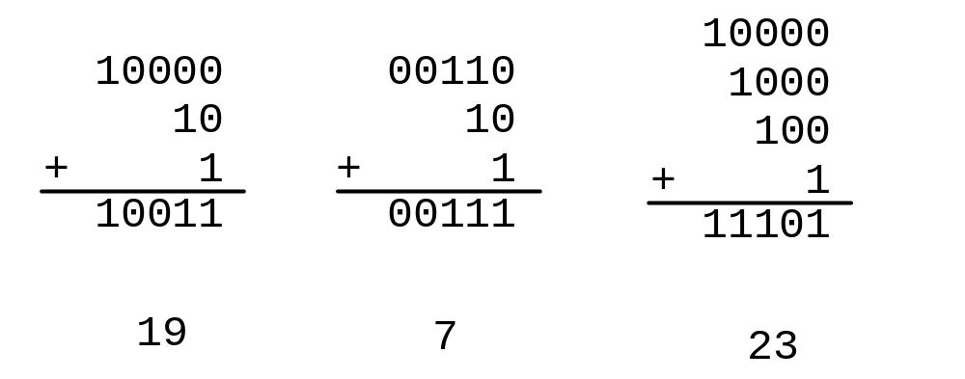
Mathematics Basis for the Game
19 is 10011 in binary. 7 is 111 in binary. 23 is 11101 in binary

Slide 12
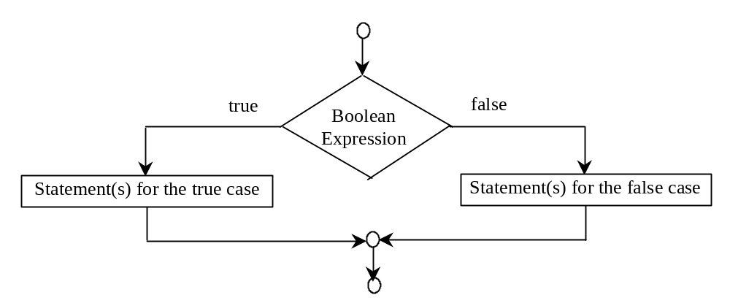
The Two-way if Statement
if (boolean-expression) {
statement(s)-for-the-true-case;
}
else {
statement(s)-for-the-false-case;
}

Slide 13
if...else Example
if (radius >= 0) {
area = radius * radius * 3.14159;
System.out.println("The area for the “
+ “circle of radius " + radius +
" is " + area);
}
else {
System.out.println("Negative input");
}

Slide 14
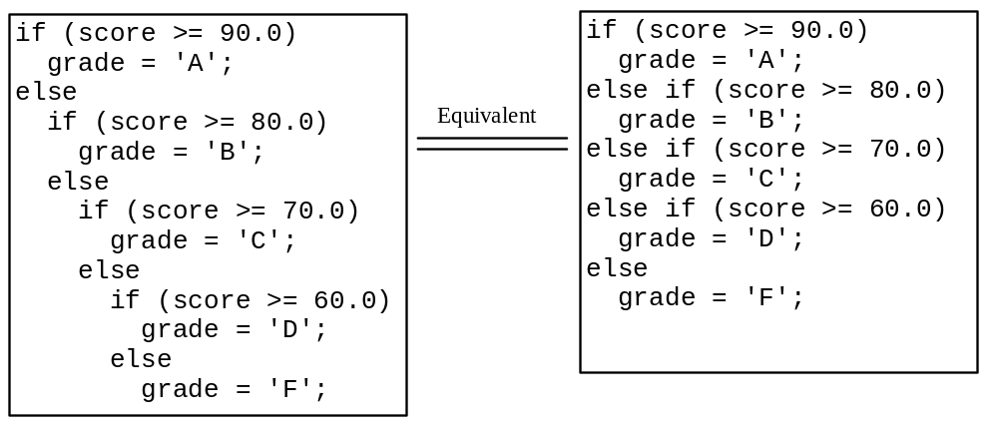
Multiple Alternative if Statements

Slide 15
Trace if-else statement
animation
Suppose score is 70.0
The condition is false
if (score >= 90.0)
grade = 'A';
else if (score >= 80.0)
grade = 'B';
else if (score >= 70.0)
grade = 'C';
else if (score >= 60.0)
grade = 'D';
else
grade = 'F';

Slide 16
Trace if-else statement
animation
Suppose score is 70.0
The condition is false
if (score >= 90.0)
grade = 'A';
else if (score >= 80.0)
grade = 'B';
else if (score >= 70.0)
grade = 'C';
else if (score >= 60.0)
grade = 'D';
else
grade = 'F';

Slide 17
Trace if-else statement
animation
Suppose score is 70.0
The condition is true
if (score >= 90.0)
grade = 'A';
else if (score >= 80.0)
grade = 'B';
else if (score >= 70.0)
grade = 'C';
else if (score >= 60.0)
grade = 'D';
else
grade = 'F';

Slide 18
Trace if-else statement
animation
Suppose score is 70.0
grade is C
if (score >= 90.0)
grade = 'A';
else if (score >= 80.0)
grade = 'B';
else if (score >= 70.0)
grade = 'C';
else if (score >= 60.0)
grade = 'D';
else
grade = 'F';

Slide 19
Trace if-else statement
animation
Suppose score is 70.0
Exit the if statement
if (score >= 90.0)
grade = 'A';
else if (score >= 80.0)
grade = 'B';
else if (score >= 70.0)
grade = 'C';
else if (score >= 60.0)
grade = 'D';
else
grade = 'F';

Slide 20
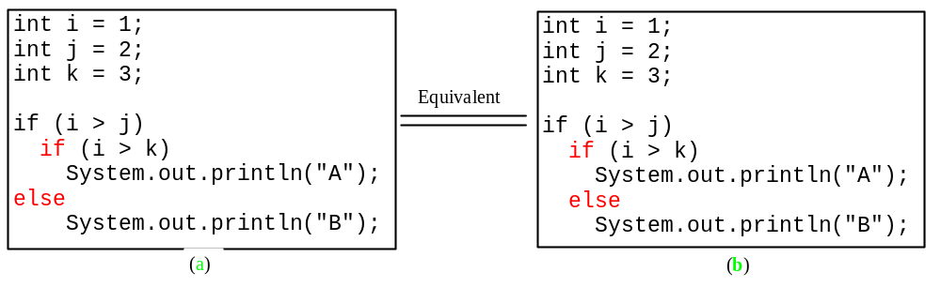
Note
The else clause matches the most recent if clause in the same block.

Slide 21
Note, cont.
Nothing is printed from the preceding statement. To force the else clause to match the first if clause, you must add a pair of braces:
int i = 1;
int j = 2;
int k = 3;
if (i > j) {
if (i > k)
System.out.println("A");
}
else
System.out.println("B");
This statement prints B.

Slide 22
Common Errors
Adding a semicolon at the end of an if clause is a common mistake.
if (radius >= 0);
{
area = radius*radius*PI;
System.out.println(
"The area for the circle of radius " +
radius + " is " + area);
}
This mistake is hard to find, because it is not a compilation error or a runtime error, it is a logic error.
This error often occurs when you use the next-line block style.
Wrong

Slide 23

TIP

Slide 24

CAUTION

Slide 25
Problem: An Improved Math Learning Tool
This example creates a program to teach a first grade child how to learn subtractions. The program randomly generates two single-digit integers number1 and number2 with number1 > number2 and displays a question such as “What is 9 – 2?” to the student. After the student types the answer in the input dialog box, the program displays a message dialog box to indicate whether the answer is correct.
SubtractionQuiz

Slide 26
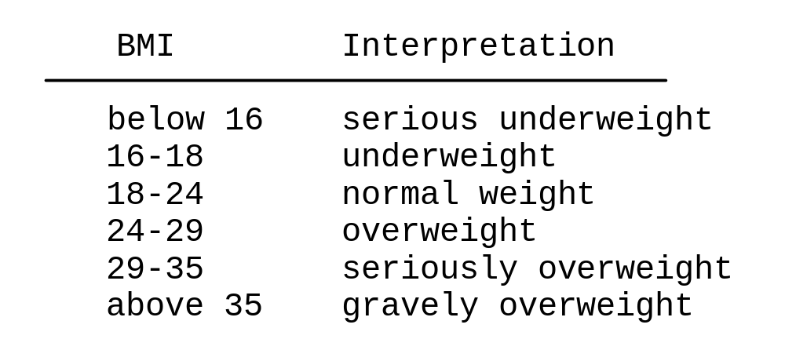
Problem: Body Mass Index
Body Mass Index (BMI) is a measure of health on weight. It can be calculated by taking your weight in kilograms and dividing by the square of your height in meters. The interpretation of BMI for people 16 years or older is as follows:
ComputeBMI

Slide 27
Problem: Computing Taxes
The US federal personal income tax is calculated based on the filing status and taxable income. There are four filing statuses: single filers, married filing jointly, married filing separately, and head of household. The tax rates for 2009 are shown below.
Marginal Tax Rate | Single | Married Filing Jointly or Qualified Widow(er) | Married Filing Separately | Head of Household
10% | $0 – $8,350 | $0 – $16,700 | $0 – $8,350 | $0 – $11,950
15% | $8,351– $33,950 | $16,701 – $67,900 | $8,351 – $33,950 | $11,951 – $45,500
25% | $33,951 – $82,250 | $67,901 – $137,050 | $33,951 – $68,525 | $45,501 – $117,450
28% | $82,251 – $171,550 | $137,051 – $208,850 | $68,525 – $104,425 | $117,451 – $190,200
33% | $171,551 – $372,950 | $208,851 – $372,950 | $104,426 – $186,475 | $190,201 - $372,950
35% | $372,951+ | $372,951+ | $186,476+ | $372,951+

Slide 28
Problem: Computing Taxes, cont.
if (status == 0) {
// Compute tax for single filers
}
else if (status == 1) {
// Compute tax for married file jointly
}
else if (status == 2) {
// Compute tax for married file separately
}
else if (status == 3) {
// Compute tax for head of household
}
else {
// Display wrong status
}
ComputeTax

Slide 29
Logical Operators
Operator Name
! not
&& and
|| or
^ exclusive or

Slide 30
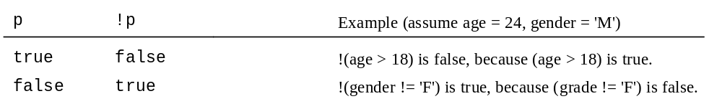
Truth Table for Operator !

Slide 31
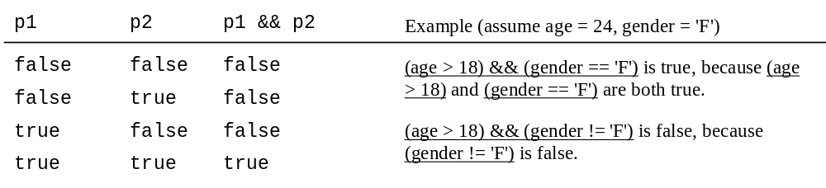
Truth Table for Operator &&

Slide 32
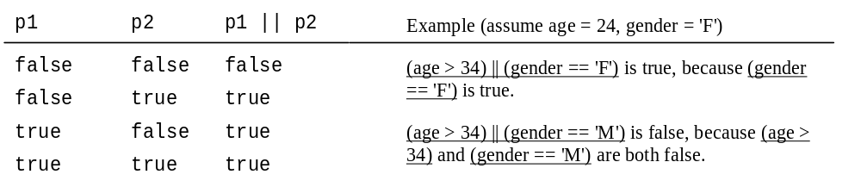
Truth Table for Operator ||

Slide 33
Examples
Here is a program that checks whether a number is divisible by 2 and 3, whether a number is divisible by 2 or 3, and whether a number is divisible by 2 or 3 but not both:
TestBooleanOperators
Run

Slide 34
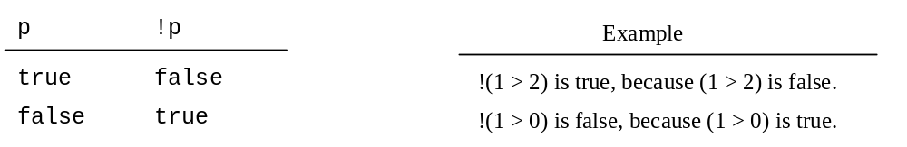
Truth Table for Operator !

Slide 35
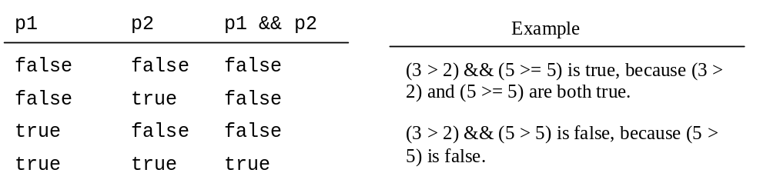
Truth Table for Operator &&

Slide 36
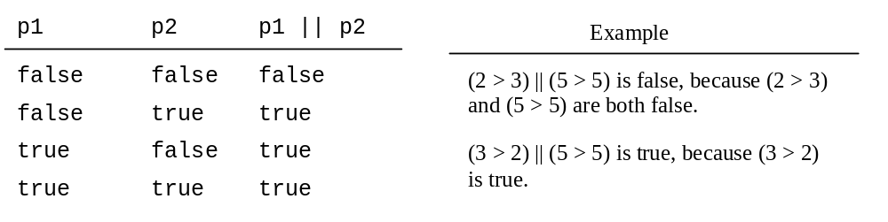
Truth Table for Operator ||

Slide 37
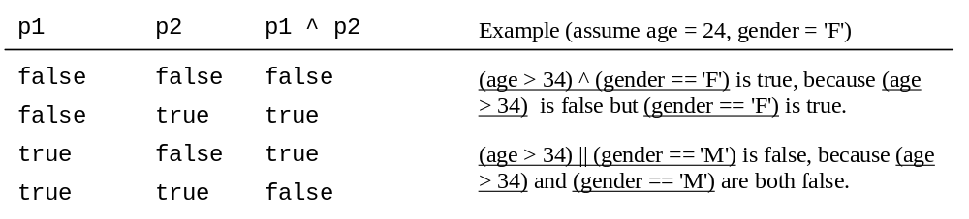
Truth Table for Operator ^

Slide 38
Examples
System.out.println("Is " + number + " divisible by 2 and 3? " +
((number % 2 == 0) && (number % 3 == 0)));
System.out.println("Is " + number + " divisible by 2 or 3? " +
((number % 2 == 0) || (number % 3 == 0)));
System.out.println("Is " + number +
" divisible by 2 or 3, but not both? " +
((number % 2 == 0) ^ (number % 3 == 0)));
TestBooleanOperators
Run

Slide 39
The & and | Operators
Companion Website
Supplement III.B, “The & and | Operators”

Slide 40
The & and | Operators
Companion Website
If x is 1, what is x after this expression?
(x > 1) & (x++ < 10)
If x is 1, what is x after this expression?
(1 > x) && ( 1 > x++)
How about (1 == x) | (10 > x++)?
(1 == x) || (10 > x++)?

Slide 41
Problem: Determining Leap Year?
This program first prompts the user to enter a year as an int value and checks if it is a leap year.
A year is a leap year if it is divisible by 4 but not by 100, or it is divisible by 400.
(year % 4 == 0 && year % 100 != 0) || (year % 400 == 0)
LeapYear
Run

Slide 42
Problem: Lottery
Write a program that randomly generates a lottery of a two-digit number, prompts the user to enter a two-digit number, and determines whether the user wins according to the following rule:
If the user input matches the lottery in exact order, the award is $10,000.
If the user input matches the lottery, the award is $3,000.
If one digit in the user input matches a digit in the lottery, the award is $1,000.
Lottery

Slide 43
switch Statements
switch (status) {
case 0: compute taxes for single filers;
break;
case 1: compute taxes for married file jointly;
break;
case 2: compute taxes for married file separately;
break;
case 3: compute taxes for head of household;
break;
default: System.out.println("Errors: invalid status");
System.exit(0);
}

Slide 44
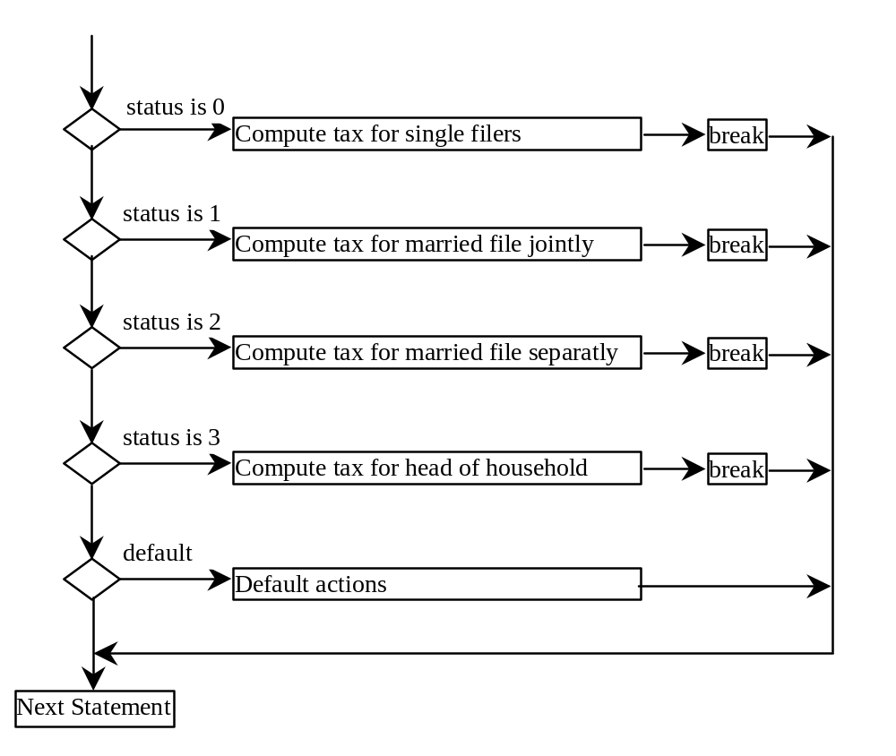
switch Statement Flow Chart

Slide 45
switch Statement Rules
The switch-expression must yield a value of char, byte, short, or int type and must always be enclosed in parentheses.
switch (switch-expression) {
case value1: statement(s)1;
break;
case value2: statement(s)2;
break;
…
case valueN: statement(s)N;
break;
default: statement(s)-for-default;
}
The value1, ..., and valueN must have the same data type as the value of the switch-expression. The resulting statements in the case statement are executed when the value in the case statement matches the value of the switch-expression. Note that value1, ..., and valueN are constant expressions, meaning that they cannot contain variables in the expression, such as 1 + x.

Slide 46
switch Statement Rules
The keyword break is optional, but it should be used at the end of each case in order to terminate the remainder of the switch statement. If the break statement is not present, the next case statement will be executed.
switch (switch-expression) {
case value1: statement(s)1;
break;
case value2: statement(s)2;
break;
…
case valueN: statement(s)N;
break;
default: statement(s)-for-default;
}
The default case, which is optional, can be used to perform actions when none of the specified cases matches the switch-expression.
The case statements are executed in sequential order, but the order of the cases (including the default case) does not matter. However, it is good programming style to follow the logical sequence of the cases and place the default case at the end.

Slide 47
Trace switch statement
animation
Suppose ch is 'a':
switch (ch) {
case 'a': System.out.println(ch);
case 'b': System.out.println(ch);
case 'c': System.out.println(ch);
}

Slide 48
Trace switch statement
animation
ch is 'a':
switch (ch) {
case 'a': System.out.println(ch);
case 'b': System.out.println(ch);
case 'c': System.out.println(ch);
}

Slide 49
Trace switch statement
animation
Execute this line
switch (ch) {
case 'a': System.out.println(ch);
case 'b': System.out.println(ch);
case 'c': System.out.println(ch);
}

Slide 50
Trace switch statement
animation
Execute this line
switch (ch) {
case 'a': System.out.println(ch);
case 'b': System.out.println(ch);
case 'c': System.out.println(ch);
}

Slide 51
Trace switch statement
animation
Execute this line
switch (ch) {
case 'a': System.out.println(ch);
case 'b': System.out.println(ch);
case 'c': System.out.println(ch);
}

Slide 52
Trace switch statement
animation
Execute next statement
switch (ch) {
case 'a': System.out.println(ch);
case 'b': System.out.println(ch);
case 'c': System.out.println(ch);
}
Next statement;

Slide 53
Trace switch statement
animation
Suppose ch is 'a':
switch (ch) {
case 'a': System.out.println(ch);
break;
case 'b': System.out.println(ch);
break;
case 'c': System.out.println(ch);
}

Slide 54
Trace switch statement
animation
ch is 'a':
switch (ch) {
case 'a': System.out.println(ch);
break;
case 'b': System.out.println(ch);
break;
case 'c': System.out.println(ch);
}

Slide 55
Trace switch statement
animation
Execute this line
switch (ch) {
case 'a': System.out.println(ch);
break;
case 'b': System.out.println(ch);
break;
case 'c': System.out.println(ch);
}

Slide 56
Trace switch statement
animation
Execute this line
switch (ch) {
case 'a': System.out.println(ch);
break;
case 'b': System.out.println(ch);
break;
case 'c': System.out.println(ch);
}

Slide 57
Trace switch statement
animation
Execute next statement
switch (ch) {
case 'a': System.out.println(ch);
break;
case 'b': System.out.println(ch);
break;
case 'c': System.out.println(ch);
}
Next statement;

Slide 58
Conditional Operator
if (x > 0)
y = 1
else
y = -1;
is equivalent to
y = (x > 0) ? 1 : -1;
(boolean-expression) ? expression1 : expression2
Ternary operator
Binary operator
Unary operator

Slide 59
Conditional Operator
if (num % 2 == 0)
System.out.println(num + “is even”);
else
System.out.println(num + “is odd”);
System.out.println(
(num % 2 == 0)? num + “is even” :
num + “is odd”);

Slide 60
Conditional Operator, cont.
(boolean-expression) ? exp1 : exp2

Slide 61
Formatting Output
Use the printf statement.
  System.out.printf(format, items);
Where format is a string that may consist of substrings and format specifiers. A format specifier specifies how an item should be displayed. An item may be a numeric value, character, boolean value, or a string. Each specifier begins with a percent sign.

Slide 62

Frequently-Used Specifiers
Specifier Output Example
%b a boolean value true or false
%c a character 'a'
%d a decimal integer 200
%f a floating-point number 45.460000
%e a number in standard scientific notation 4.556000e+01
%s a string "Java is cool"

Slide 63
Operator Precedence
var++, var--
+, - (Unary plus and minus), ++var,--var
(type) Casting
! (Not)
*, /, % (Multiplication, division, and remainder)
+, - (Binary addition and subtraction)
<, <=, >, >= (Comparison)
==, !=; (Equality)
^ (Exclusive OR)
&& (Conditional AND) Short-circuit AND
|| (Conditional OR) Short-circuit OR
=, +=, -=, *=, /=, %= (Assignment operator)

Slide 64
Operator Precedence and Associativity
The expression in the parentheses is evaluated first. (Parentheses can be nested, in which case the expression in the inner parentheses is executed first.) When evaluating an expression without parentheses, the operators are applied according to the precedence rule and the associativity rule.
If operators with the same precedence are next to each other, their associativity determines the order of evaluation. All binary operators except assignment operators are left-associative.

Slide 65
Operator Associativity
When two operators with the same precedence are evaluated, the associativity of the operators determines the order of evaluation. All binary operators except assignment operators are left-associative.
a – b + c – d is equivalent to ((a – b) + c) – d
Assignment operators are right-associative. Therefore, the expression
a = b += c = 5 is equivalent to a = (b += (c = 5))

Slide 66

Example
Applying the operator precedence and associativity rule, the expression 3 + 4 * 4 > 5 * (4 + 3) - 1 is evaluated as follows:

Slide 67
Operand Evaluation Order
Companion Website
Supplement III.A, “Advanced discussions on how an expression is evaluated in the JVM.”

Slide 68
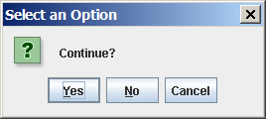
(GUI) Confirmation Dialogs
int option = JOptionPane.showConfirmDialog
(null, "Continue");

Slide 69
Problem: Guessing Birth Date
The program can guess your birth date. Run to see how it works.
GuessBirthDateUsingConfirmationDialog

